Slide 1
Artificial Neural Network Lecture#12 Dr. Muhammad Fayaz

Slide 2
Revision
Artificial Neural Network
Structure of Artificial Neural Network
Activation Functions
Sigmoid
Tangent Sigmoid
Rectified Linear Unit (ReLU)
Linear/Identical
SoftMax
Example

Slide 3
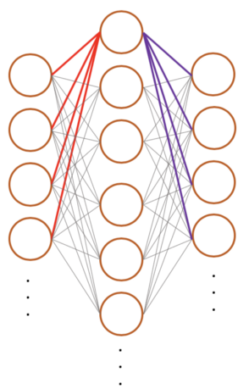
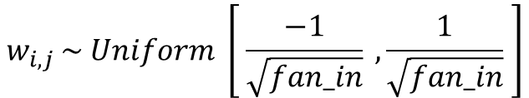
Key-points to remember for weights initialization
Weights Should be Small
Weights Should not be Same
Weights Should have good variance
Methods for Weight Initialization
1. Uniform Distribution
A uniform distribution draws a random value from the range [lower, upper] where every value inside this range has equal probability of being drawn.
Lower ,
Upper
$$w_{i,j }\sim Uniform \left[ \frac{−1}{\sqrt{fan_in}} ,\frac{1}{\sqrt{fan_in}} \right]$$
fan-in
fan-out
fan_in is the number of input connections to a hidden node (neuron)[In this simplified diagram, 4]
fan_out is the number of output connections from a hidden layer node (In this simplified diagram, 4).

Slide 4

Weight Initialization
2. Xavier / Gorat
This can be further divided into two parts
2.1 Xavier Normal
Normal distribution, also known as the Gaussian distribution, is a probability distribution that is symmetric about the mean, showing that data near the mean are more frequent in occurrence than data far from the mean.
$$w_{i,j }\sim N \left[0, \sqrt{\frac{2}{fan_{in}+fan_{out}}} \right]$$
fan_in is the number of input connections to a hidden node (neuron)[In this simplified diagram, 4]
fan_out is the number of output connections from a hidden layer node (In this simplified diagram, 4).
fan-in
fan-out

Slide 5
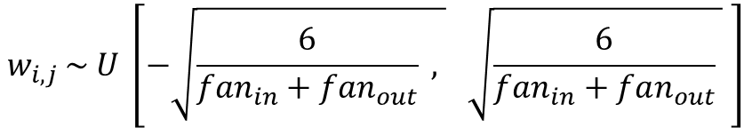
Weight Initialization
2.2 Xavier Uniform
$$w_{i,j }\sim U \left[−\sqrt{\frac{6}{fan_{in}+fan_{out}} , } \sqrt{\frac{6}{fan_{in}+fan_{out}} } \right]$$
fan-in
fan-out
fan_in is the number of input connections to a hidden node (neuron)[In this simplified diagram, 4]
fan_out is the number of output connections from a hidden layer node (In this simplified diagram, 4).

Slide 6
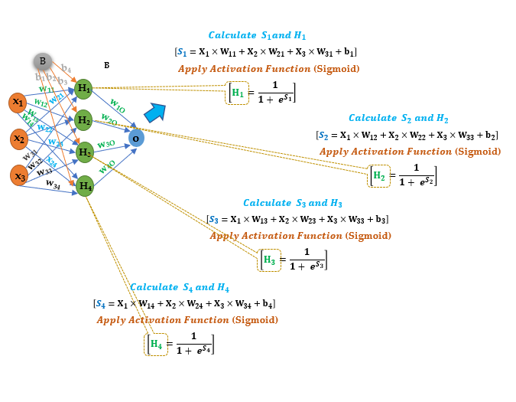
Simple Example (ANN)- Alternative
Supposed Values
X₁
X₂
X₃
B₁
B₂
B₃
b₄
W₁₁
W₁₂
W₁₃
W₁₄
W₂₁
W₂₂
W₂₃
W₂₄
W₃₁
W₃₂
W₃₃
W₃₄
W₄₁
W₄₂
W₄₃
W₄₄
σ: Activation Function
Neuron Activation = σ( Σ (weights * inputs) + bias )

Slide 7
Perceptron
A perceptron is a network with two layers, one input and one output.
Input Layer
1
W₁₃
2
W₂₃
Output Layer
W₃₃
3
Output
3
W₄₃
4
W₅₃
4

Slide 8
Multilayer Perceptron
A MLP consists of at least three layers: an input layer, a hidden layer, and an output layer.
1
b₁₁
Hidden Layer
b₁₅
b₁₂
b₁₃
Input Layer
b₁₄
1
W₁₁
1
W₁₂
W₁₃
W₂₁
W₂₂
2
W₂₃
Output Layer
2
W₁₃
W₃₂
W₂₃
W₃₃
3
Output
W₃₁
3
W₃₃
W₂₄
W₁₄
3
W₄₂
W₄₃
W₄₁
W₃₄
4
W₅₃
4
W₄₃
W₄
4

Slide 9
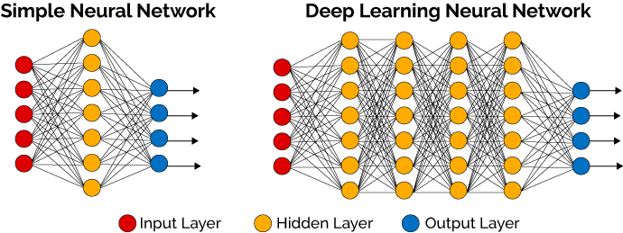
Deep Learning and Deep Learning Neural Network
Deep learning is a class of machine learning algorithms that uses multiple layers to progressively extract higher level features from the raw input.
Characteristic of Deep Learning
Deep learning requires huge amounts of training data
Deep learning requires extensive computing power
Architectures of deep learning algorithms are complex
Deep Learning Neural Network
A deep neural network (DNN) is an artificial neural network (ANN) with multiple layers between the input and output layers.

Slide 10
Deep Artificial Neural Network
1
1
b₁₁
Hidden
Layer 1
b₁₅
b₁₂
Hidden
Layer 2
Input
Layer
b₁₃
b₁₄
1
W₁₁
_{H11}
1
_{H14}
_{H12}
1
W₁₂
_{H13}
_{H21}
W₁₃
2
_{H22}
Output Layer
W₂₁
W₂₂
_{H23}
2
2
_{H32}
W₂₃
W₁₃
_{H31}
Inputs
W₂₃
_{H11}
3
W₃₁
W₃₂
3
_{H33}
Output
_{H34}
W₃₃
W₃₃
W₂₄
W₁₄
3
W₄₂
_{H41}
3
W₄₁
_{H42}
_{H24}
W₃₄
_{H42}
W₄₃
4
4
W₄₃
_{H41}
_{H43}
W₄₄
4
4

Slide 11
Deep Artificial Neural Learning
1
1
b₁₁
b₁₁
Hidden Layer
b₂₁
b₁₃
Hidden Layer
b₁₅
b₁₂
Input Layer
b₁₃
b₁₄
1
W₁₁
_{H11}
1
_{H14}
_{H12}
Output Layer
1
_{H13}
W₁₁
W₁₂
_{H21}
W₁₂
W₂₁
W₂₂
2
_{H22}
W₂₁
1
_{H23}
2
2
_{H31}
_{H32}
W₂₂
W₁₃
W₁₃
W₂₃
_{H11}
W₂₃
2
W₃₁
W₃₂
3
_{H33}
Output
W₃₃
_{H34}
W₃₁
W₂₄
W₁₄
W₃₂
3
W₄₂
_{H41}
3
3
W₄₁
_{H42}
_{H24}
W₃₃
W₃₄
_{H42}
W₄₂
4
W₄₁
4
W₄₃
_{H41}
W₄₃
_{H43}
W₄
4
4

Slide 12
How to Construct a Neural Network?
Following points are required while constructing a neural network
Number of input layer’s nodes/neurons
Number of hidden layer nodes/neurons
Number of output layer’s neurons
Activation Function on Hidden Layer nodes
Activation function on output layer’s nodes
Binary Classification Problem
Multiclass classification Problem
Regression Problem

Slide 13
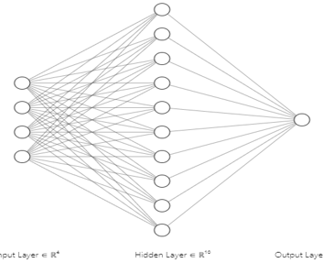
How to Construct a Neural Network?
Independent Variables/Features/Attributes
Dependent Variables/Features/Attributes
Humidity | Temperature | Illumination | Air Quality | Class
Case-1: Map Independent Variables/Features/Attributes to input layer’s nodes
Here we have four independent variables/features/attributes, hence the number of neurons in the input layer must be 4

Slide 14
How to Construct Neural Network?
Dependent Variables/Features/Attributes
Independent Variables/Features/Attributes
Case-2: Hidden Layer Nodes: The number of neurons in the hidden layer is a trial and error type of practice.
You can specify any number of nodes/neurons in the hidden layer
Humidity | Temperature | Illumination | Air Quality | Class

Slide 15
How to Construct a Neural Network?
Dependent Variables/Features/Attributes
Independent Variables/Features/Attributes
Case-3: Binary Classification (when we have two categories in the output variable/class/depend variable)
The number of nodes/neurons in the output layer depend on the number of categories in the output variable/depend variable.
In case of binary classification only one node will be specified in the output layer.
Humidity | Temperature | Illumination | Air Quality | Class
 |  |  |  | a
 |  |  |  | b
 |  |  |  | b
 |  |  |  | b
 |  |  |  | a
 |  |  |  | a
 |  |  |  | b
 |  |  |  | a

Slide 16
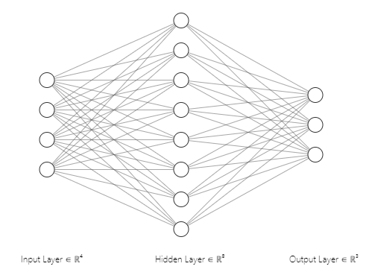
How to Construct a Neural Network?
Dependent Variables/Features/Attributes
Independent Variables/Features/Attributes
Case 4-Multiclass Classification: (when we have three categories in the output variable/class/depend variable):
The number of nodes/neurons in the output layer depend on the number of categories in the output variable/depend variable.
In case of multiclass classification, the number of nodes/neurons in the output layer must be equal to
the number of categories/classes in the dependent variable.
Humidity | Temperature | Illumination | Air Quality | Class
 |  |  |  | a
 |  |  |  | a
 |  |  |  | b
 |  |  |  | b
 |  |  |  | c
 |  |  |  | c
 |  |  |  | b
 |  |  |  | a

Slide 17
How to Construct a Neural Network?
Dependent Variables/Features/Attributes
Independent Variables/Features/Attributes
Case 5-Activation Function(Input layer nodes):
No Activation Function is required on input layer’s neurons/nodes
Humidity | Temperature | Illumination | Air Quality | Class
 |  |  |  | a
 |  |  |  | a
 |  |  |  | b
 |  |  |  | b
 |  |  |  | c
 |  |  |  | c
 |  |  |  | b
 |  |  |  | a

Slide 18
How to Construct a Neural Network?
Dependent Variables/Features/Attributes
Independent Variables/Features/Attributes
Case 6-Activation Function(hidden layer’s nodes):
Almost all activation function can be applied on the hidden layer’s nodes/neurons
Humidity | Temperature | Illumination | Air Quality | Class
 |  |  |  | a
 |  |  |  | a
 |  |  |  | b
 |  |  |  | b
 |  |  |  | c
 |  |  |  | c
 |  |  |  | b
 |  |  |  | a

Slide 19
How to Construct a Neural Network?
Dependent Variables/Features/Attributes
Independent Variables/Features/Attributes
Case 7-Activation Function(output layer’s layer’s nodes):
In case of binary classification, the activation function must be sigmoid/tanh sigmoid function on the output layer’s nodes.
Humidity | Temperature | Illumination | Air Quality | Class
 |  |  |  | a
 |  |  |  | a
 |  |  |  | b
 |  |  |  | b
 |  |  |  | b
 |  |  |  | b
 |  |  |  | b
 |  |  |  | a

Slide 20
How to Construct a Neural Network?
Independent Variables/Features/Attributes
Dependent Variables/Features/Attributes
Case 8-Activation Function(output layer’s layer’s nodes):
In case of multiclass classification the softmax activation function must be applied on the output layer’s nodes.
Humidity | Temperature | Illumination | Air Quality | Class
 |  |  |  | a
 |  |  |  | a
 |  |  |  | b
 |  |  |  | b
 |  |  |  | c
 |  |  |  | c
 |  |  |  | b
 |  |  |  | a

Slide 21
How to Construct a Neural Network?
Independent Variables/Features/Attributes
Case 9-Activation Function(output layer’s layer’s nodes):
In case of regression the linear/identical activation function must be applied on the output layer’s nodes.
And there must be always one node/neuron in the output layer.
Humidity | Temperature | Illumination | Air Quality | Class
 |  |  |  | 10.4
 |  |  |  | 11
 |  |  |  | 13.5
 |  |  |  | 14
 |  |  |  | 13
 |  |  |  | 12.4
 |  |  |  | 17
 |  |  |  | 18.5

Slide 22
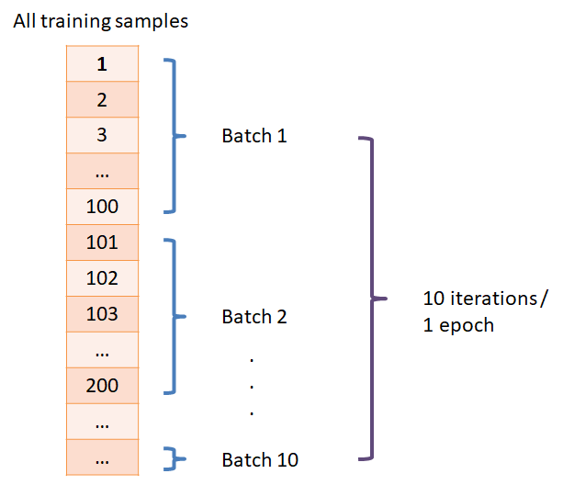
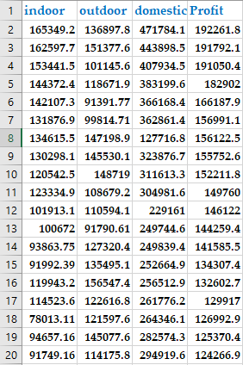
Terminologies
Epoch
In terms of artificial neural networks, an epoch refers to one cycle through the full training dataset.
Usually, training a neural network takes more than a few epochs.
In other words, if we feed a neural network the training data for more than one epoch in different patterns, we hope for a better generalization when given a new "unseen" input (test data).

Slide 23
Terminologies
Batch
The batch is the division of training data into packets/Samples
Batch Size = Number of Rows in a Batch

Slide 24
Terminologies
Iteration
An epoch is often mixed up with an iteration.
Iterations is the number of batches or steps through partitioned packets of the training data, needed to complete one epoch.
Each time the weights are updated, it is known as an iteration
Training Data = (batch size * number of iterations)
Epoch = (Number of iterations * batch size) / Total number of instances in training
Number of iterations = Total number of batches in training dataset

Slide 25
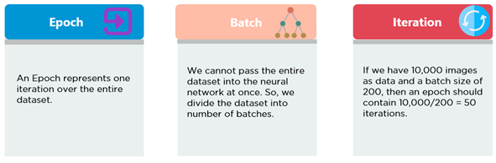
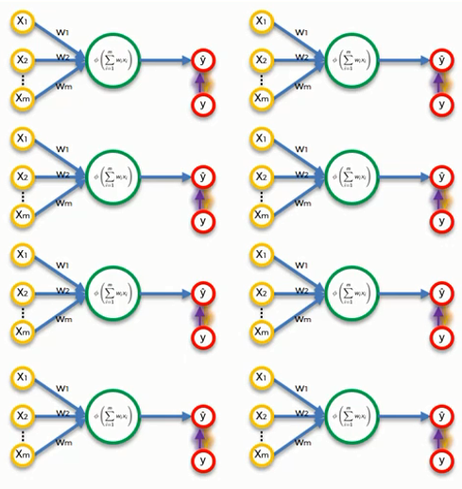
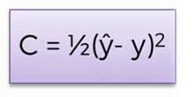

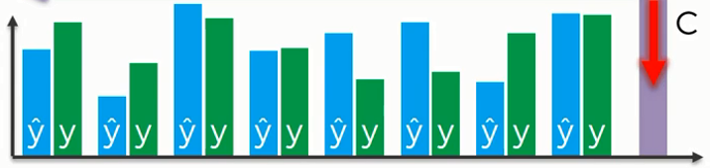
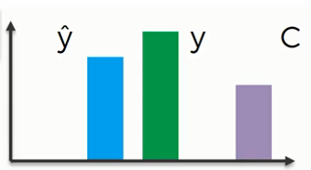
Terminologies
Cost/Loss
Predicted
Actual
Predicted
Actual

Slide 26
Terminologies

Slide 27
Practice
Given: Attribute1, Attribute2, Attribute3 , Attribute4, and Attribute5 are independent variables and class is a dependent variable.
Split the data into different batches (batch size is 3)
Calculate the number of iterations if the batch size is 3 and the number of epochs are 2.

Slide 28
Different types of Neural Network
Feedforward Neural Network – Artificial Neuron
Feed Forward Back Propagation Neural Network
Perceptron (Multilayer Perceptron) & ANN
Radial Basis Function Neural Network
Convolutional Neural Network
Recurrent Neural Network(RNN) –
Long Short-Term Memory

Slide 29
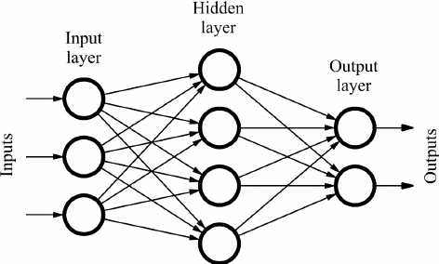
Feedforward Neural Network
It is one of the simplest types of artificial neural networks.
In a feedforward neural network, the data passes through different input nodes, hidden layer nodes until it reaches the output node.
In other words, the data moves in only one direction from the first range until it reaches the output node.
Data move in only one direction.
A feedforward neural network may consist of a single layer or may contain hidden layers.
In a feed forward neural network, the products of the inputs and their weights are calculated. This is then fed to the output.

Slide 30
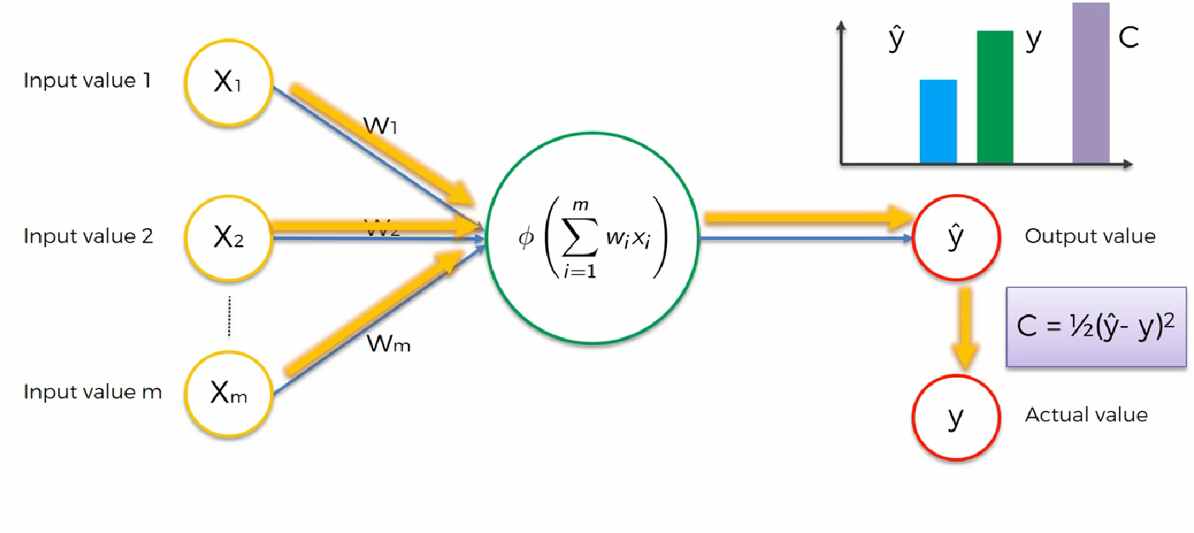
Feed Forward Neural Network

Slide 31
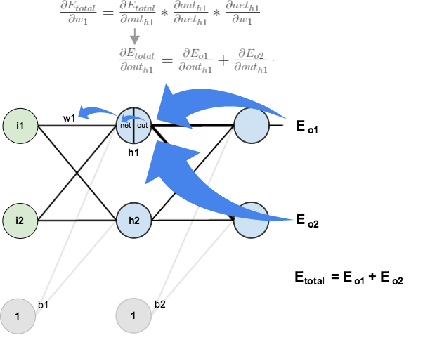
Back Propagation
Back-propagation is the essence of neural net training. It is the method of fine-tuning the weights of a neural net based on the error rate obtained in the previous epoch (i.e., iteration).
Proper tuning of the weights allows you to reduce error rates and to make the model reliable by increasing its generalization.
Backpropagation is a training algorithm consisting of 2 steps:
Feedforward the values.
Calculate the error and propagate it back to the earlier layers.

Slide 32
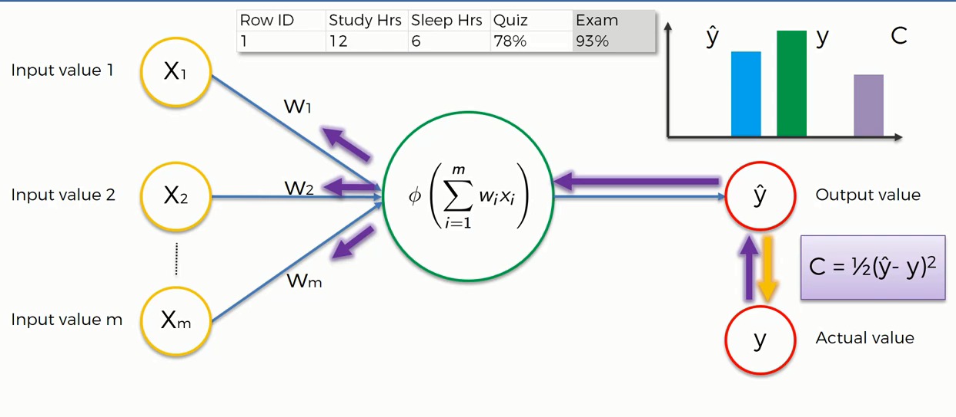
Back Propagation

Slide 33










Simple Example (ANN)
Supposed Values
X₁
X₂
X₃
B₁
B₂
B₃
b₄
W₁₁
W₁₂
W₁₃
W₁₄
W₂₁
W₂₂
W₂₃
W₂₄
W₃₁
W₃₂
W₃₃
W₃₄
W₄₁
W₄₂
W₄₃
W₄₄
$$Calculate{ S}_{1}and H_{1}$$
B
_{B}
$$\left[S_{1}=X_{1}×W_{11}+X_{2}×W_{21}+X_{3}×W_{31}+b_{1}\right]$$
b₁
b₄
$Apply Activation Function$ (Sigmoid)
b₂
w₁₁
b₃
H₁
$$\left[H_{1}=\frac{1}{1+ e^{S_{1}}}\right]$$
x₁
w₂₁
_{W12}
w_{1O}
W₁₃
H₂
w_{2O}
$$Calculate{ S}_{2} and H_{2}$$
w₁₄
x₂
w₂₂
o
w₂₃
w_{3O}
$$\left[S_{2}=X_{1}×W_{12}+X_{2}×W_{22}+X_{3}×W_{33}+b_{2}\right]$$
w₃₁
H₃
$Apply Activation Function$ (Sigmoid)
w₃₂
x₂₄
w_{4O}
$$\left[H_{2}=\frac{1}{1+ e^{S_{2}}}\right]$$
x₃
w₃₃
w₃₄
H₄
$$Calculate{ S}_{3 }and H_{3}$$
$$\left[S_{3}=X_{1}×W_{13}+X_{2}×W_{23}+X_{3}×W_{33}+b_{3}\right]$$
$Apply Activation Function$ (Sigmoid)
$$\left[H_{3}=\frac{1}{1+ e^{S_{3}}}\right]$$
$$Calculate{ S}_{4 }and H_{4}$$
$$\left[S_{4}=X_{1}×W_{14}+X_{2}×W_{24}+X_{3}×W_{34}+b_{4}\right]$$
$Apply Activation Function$ (Sigmoid)
$$\left[H_{4}=\frac{1}{1+ e^{S_{4}}}\right]$$

Slide 34
Appendix

Slide 35
Quiz#06

